Slide 1
Control System Design (MECH 473) Session #2 Introduction to Simulink, QuaRc and Sensor Calibration
Presented by:
Hamid Ebrahimi Orimi
h.e.orimi@hotmail.com

Slide 2
First report
1. Provide a mathematical model for the DC motor and loads (inertia and generator), for the driving circuit, and for the feedback.
Note that the motor is GM9236, or GM9413.
Two inertial disks will be used in the project.
J1=1.4 e-4 kg m2, J2=2.6 e-4 kg m2. Motor have a reduction gear ratio of 5.9.
2. Assuming a continuous model with no controller (ie: unity forward proportional gain only), select a generator load (resistance = 5W) so the system feedback response to a position step input is highly oscillatory (underdamped).
Using SIMULINK, show the system step response. Provide a Bode diagram and show/discuss the correlation between the phase margin and damping ratio.
It should be noted that for a disk (any generator) load, the open-loop system is always overdamped and thus an underdamped system can never be obtained.
Do not forget to include the amplifier gain Ka = 2.5 V/V used to drive the DC motor/load system.
3. According to the frequency domain method, design a cascade controller for 20% overshoot. Show/discuss the differences in system response between a lead and a lag compensator. For each controller, simulate the position step response and correlate with its Bode diagram. Since the system is overdamped, it should be noted that conventional lead or lag compensation methods cannot achieve an underdamped system. You must use a “lag-type” controller to “shape” your Bode diagram to achieve an underdamped system.
4. Once the proper controller has been selected in 3, convert the continuous controller into a digital controller (see text: Chapter 13, up to page 526). Using SIMULINK, simulate the lag digital controller and continuous plant. Provide responses and discussions for a variety of proper and improper sampling times.

Slide 3
First report
3. According to the frequency domain method, design a cascade controller for 20% overshoot.
Show/discuss the differences in system response between a lead and a lag compensator.
For each controller, simulate the position step response and correlate with its Bode diagram.
Since the system is overdamped, it should be noted that conventional lead or lag compensation methods cannot achieve an underdamped system. You must use a “lag-type” controller to “shape” your Bode diagram to achieve an underdamped system.
4. Once the proper controller has been selected in 3, convert the continuous controller into a digital controller (see text: Chapter 13, up to page 526).
Using SIMULINK, simulate the lag digital controller and continuous plant.
Provide responses and discussions for a variety of proper and improper sampling times.

Slide 4
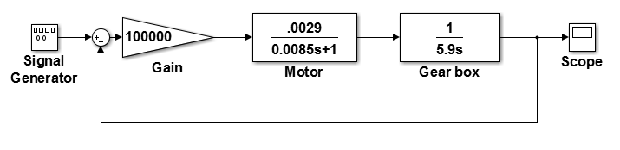
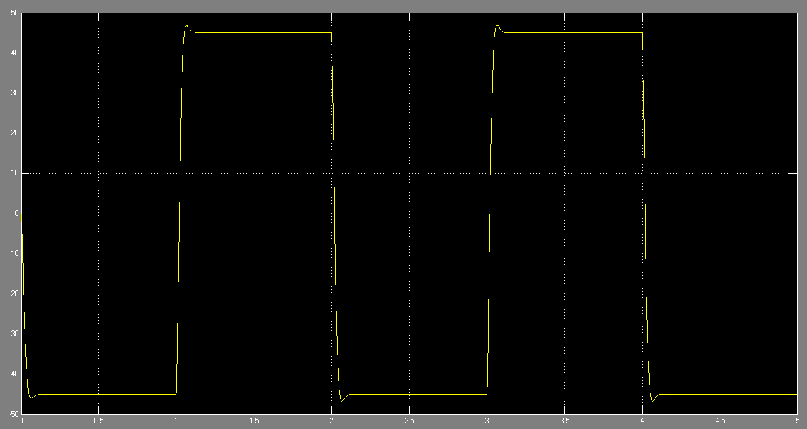
1. Simulink
Simulink Model for Motor and gearbox
The result

Slide 5
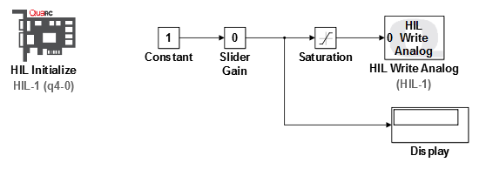
2. QuaRC DAQ card
Build the following model in Simulink
Saturation block: To have limitation for the voltage (-6 to 6 v)
Slider Gain: To change the input voltage (-5 to 5 v)
Display: To see the output voltage from Simulink and compare with DAQ card output which is measured by DMM (multi-meter)

Slide 6
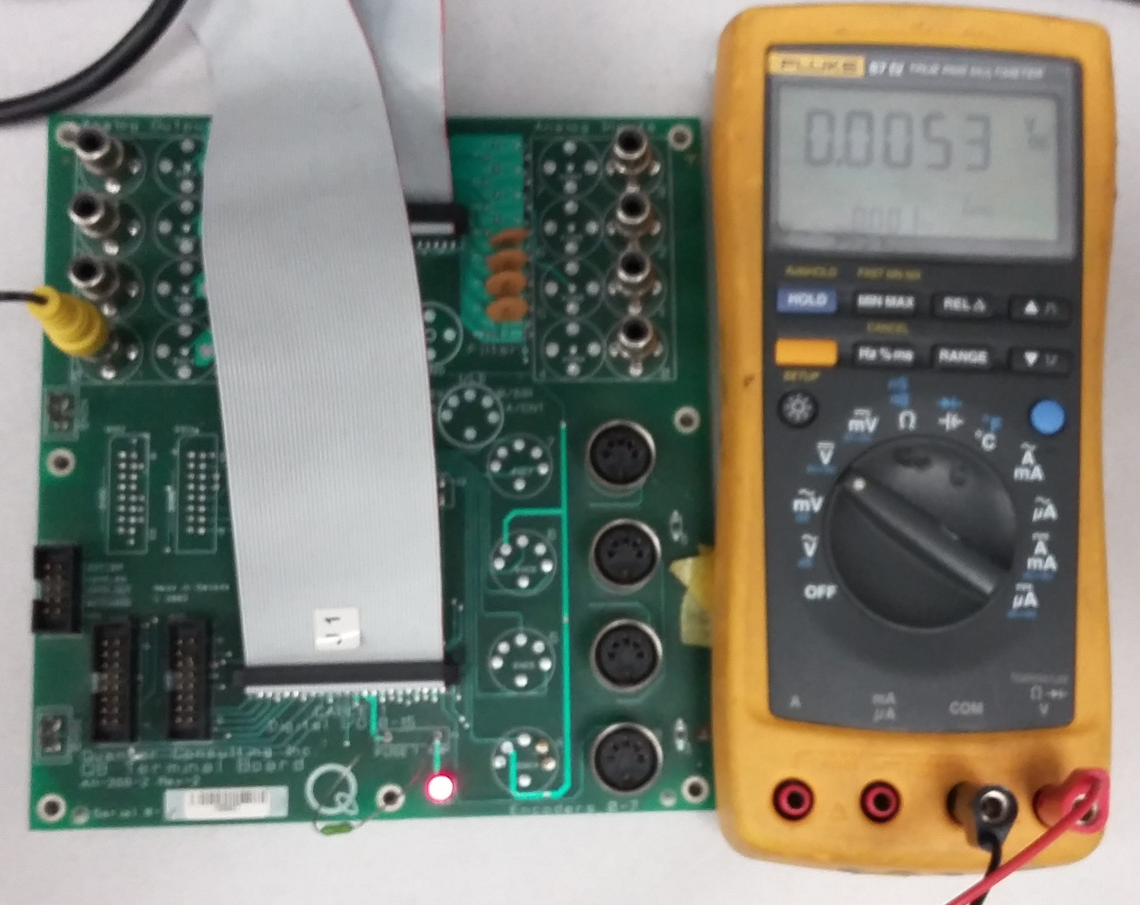
2. QuaRC DAQ card
Connect the DAQ card output to DMM as follow:
Go to QuaRC/Options and check the solver pane
Start time:0, stop time: Inf, solver: discrete, Type: fixed step
Build the model, Connect to target and execute

Slide 7
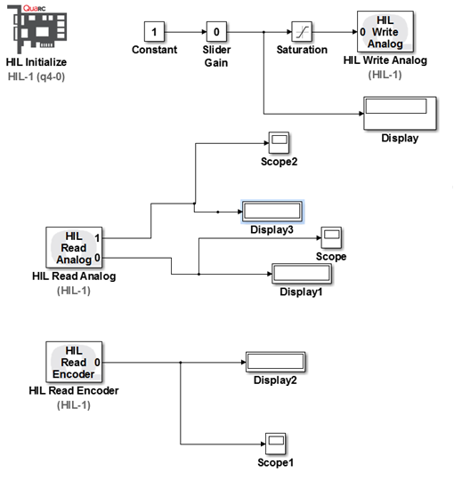
3. QuaRC DAQ card
Complete Simulink model as follow:

Slide 8
3. QuaRC DAQ card
Connect the DAQ card to Op
the input voltage is prepared by DAQ card (Simulink command) instead of power supply (last class)
Connect the Op output to the motor
Connect potentiometer to the DAQ card and power supply (5v)
Connect the motor to the DAQ card

Slide 9
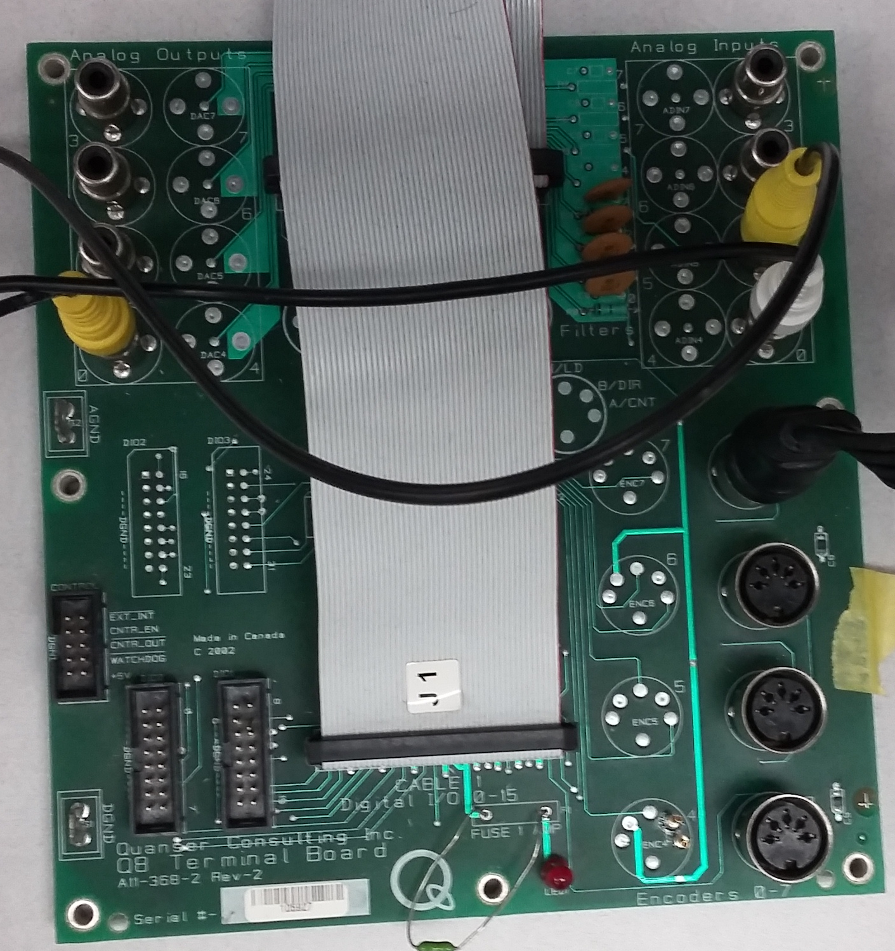
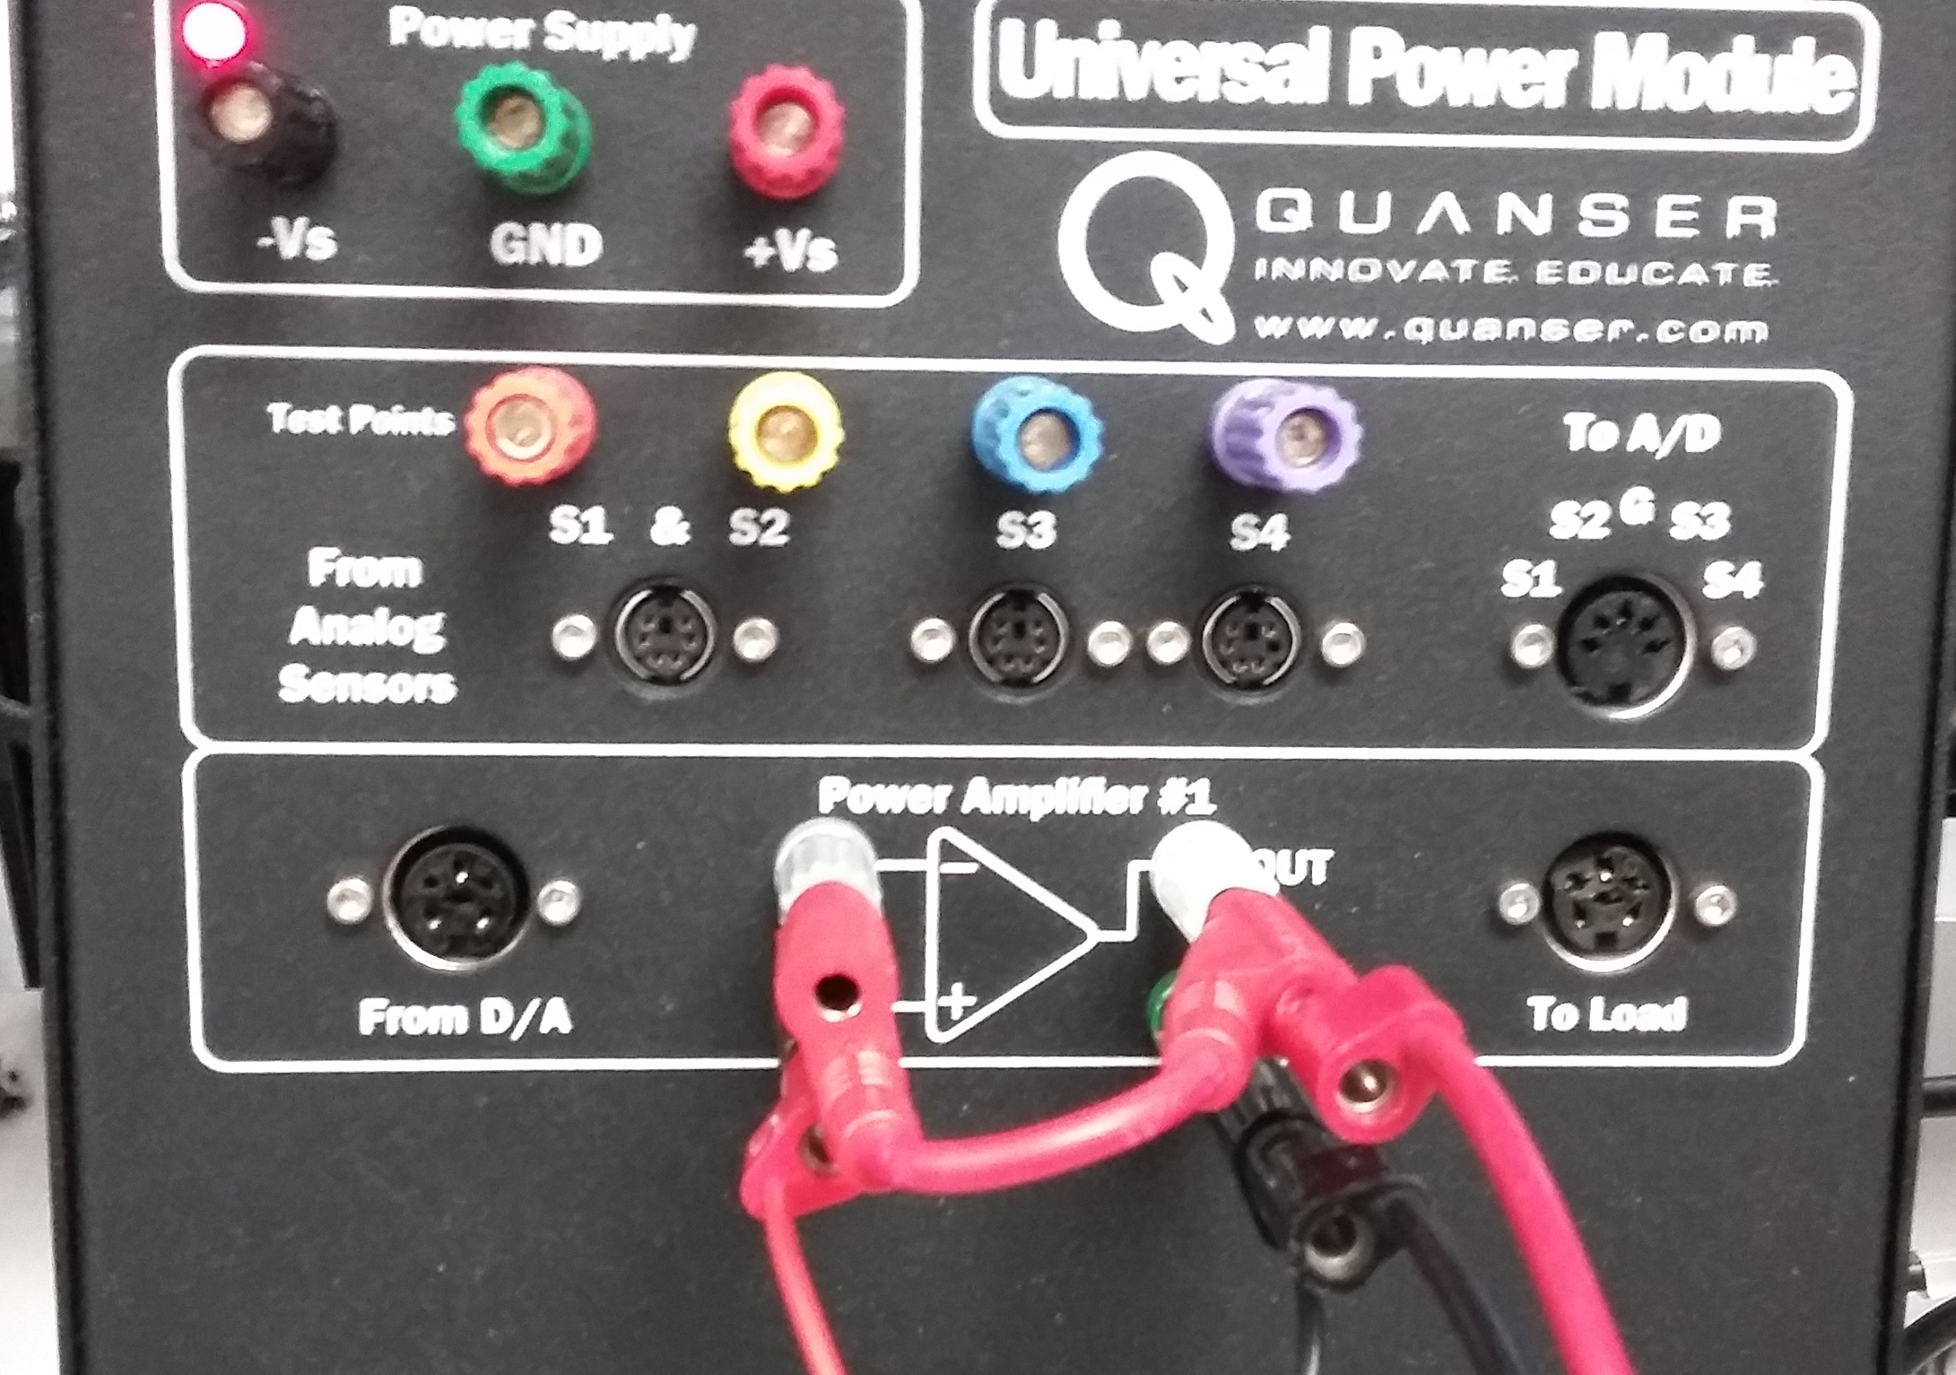
3. QuaRC DAQ card

Slide 10
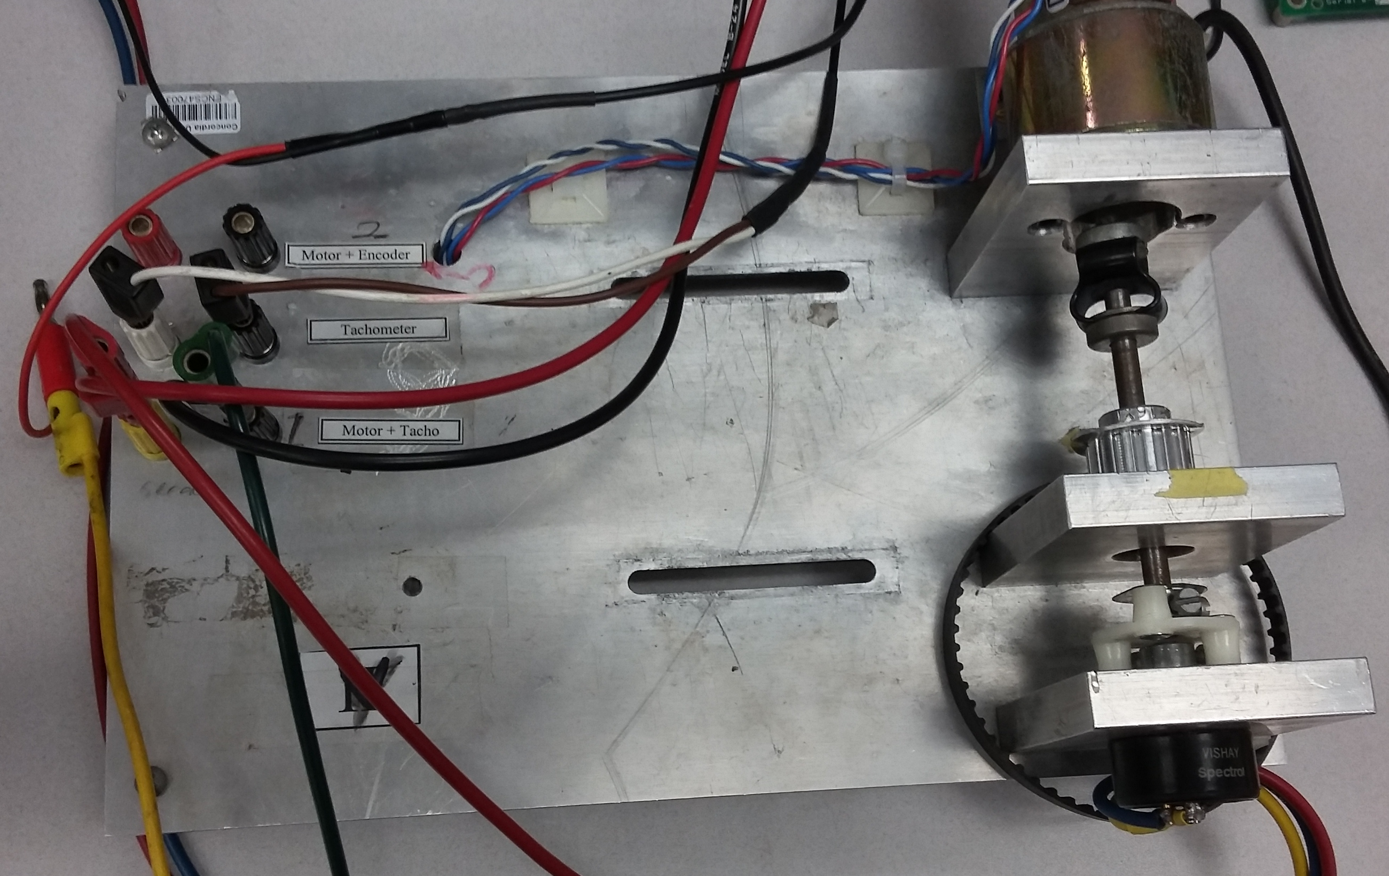
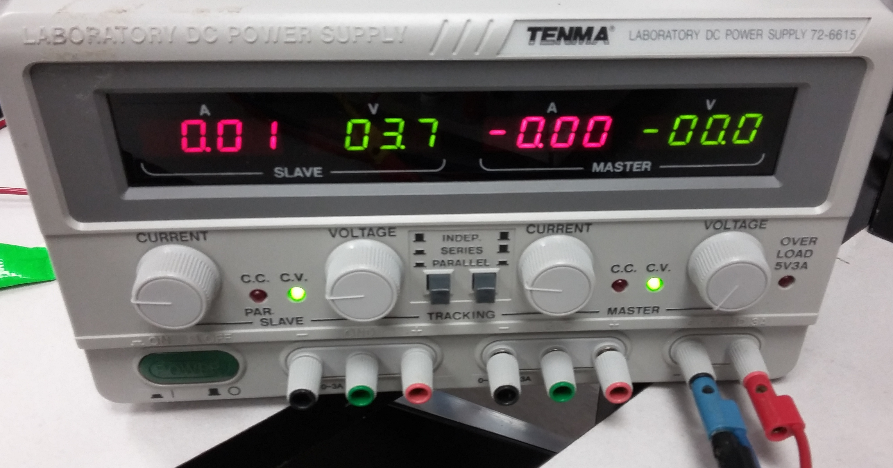
3. QuaRC DAQ card

Slide 11
3. Calibration
Find the relation between Simulink sensors’ output and measured (real) value to calibrate the Simulink outputs.

